Slide 1





Build AI Powered Apps
Using AWS Bedrock and Serverless Echo System
GET STARTED
Crafting the Cloud

Slide 2


The AI Race

Slide 3



Crafting the Cloud
Ahmed Ali
03.
04.
05.
06.
AWS Community Builder
Tech Lead
YouTube Content Creator
Jiu-Jitsu Fighter

Slide 4
Crafting the Cloud
Table of Content
-
-
-
-
-
-
The Confidence Gap: Why AI Seems Hard?
The Use Case
The "How-To" Guide: Introducing Our Tools
The Blueprint: Our Application Architecture
Proof in Action: Demo
Future Enhancements

Slide 5




Crafting the Cloud
Why This Session is Different?
Amazon Bedrock
100% Serverless
Proofed Result
“HOW”
Instead of
“WHAT”
Deploy a Runnable Application
No
Infrastructure
How do you integrate Bedrock into your application? How does it talk to your code? How do you make it smart with your own data?"
Let’s Build

Slide 6
Crafting the Cloud
What is AI Powered Application ?

Slide 7

Crafting the Cloud
The Confidence Gap
Why AI Seems Hard ?
Lack of Knowledge
No AI/ML knowledge to build suitable models
Infrastructure Limitation
No access to a complex infrastructure with GPUs

Slide 8

Crafting the Cloud
The Use Case
Career Development App.
External Courses
Coursera , PluralSight, Deeplearning.io and AWS Skill Builder
Internal Courses
Company Classrooms and Partner Training Center

Slide 9

Crafting the Cloud
The Use Case
Career Development App.

Slide 10






Crafting the Cloud
The Use Case
Career Development App.
Current Role
Target Role
Back-End
User
Web App.
User Request &
Recommended Courses
AI Model
Database
Internal Courses Database

Slide 11







Crafting the Cloud
AWS Services
Lambda
API Gateway
DynamoDB
OpenSearch
S3
Bedrock
CloudFormation

Slide 12
Crafting the Cloud
AWS Services
The Breakdown

Slide 13
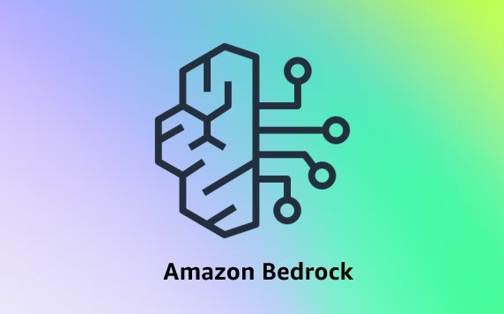
Crafting the Cloud
Amazon Bedrock
Fast-track your generative AI applications and agents from prototype to production with confidence
Foundation Models
Knowledge Base
Leading foundation models like Anthropic Claude, Cohere .. etc.
Build a fully customizable Knowledge Base with maximum flexibility.
One API for multiple models.
Query and test your Knowledge Base in the test window.
Pay for what you use.

Slide 14
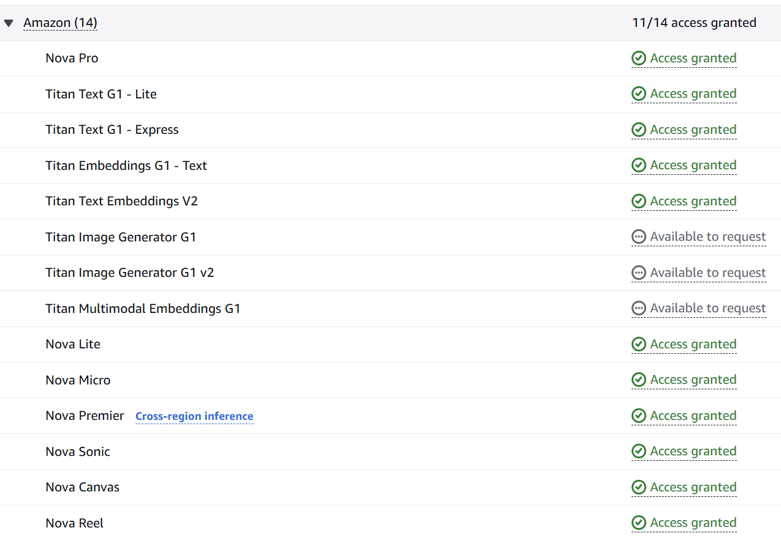
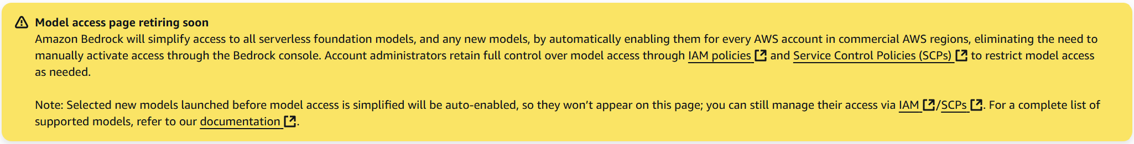
Crafting the Cloud
Amazon Bedrock
Model Access
Request access to use any of the provided foundation models.
Auto approved access.

Slide 15

Crafting the Cloud
Human Brain &
Experience
Model & Knowledge Base

Slide 16

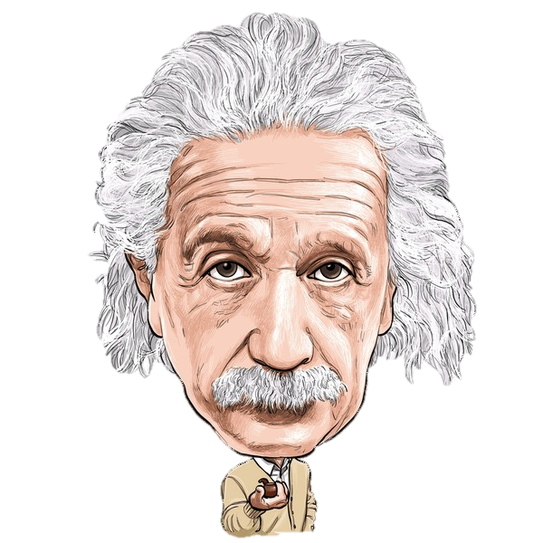
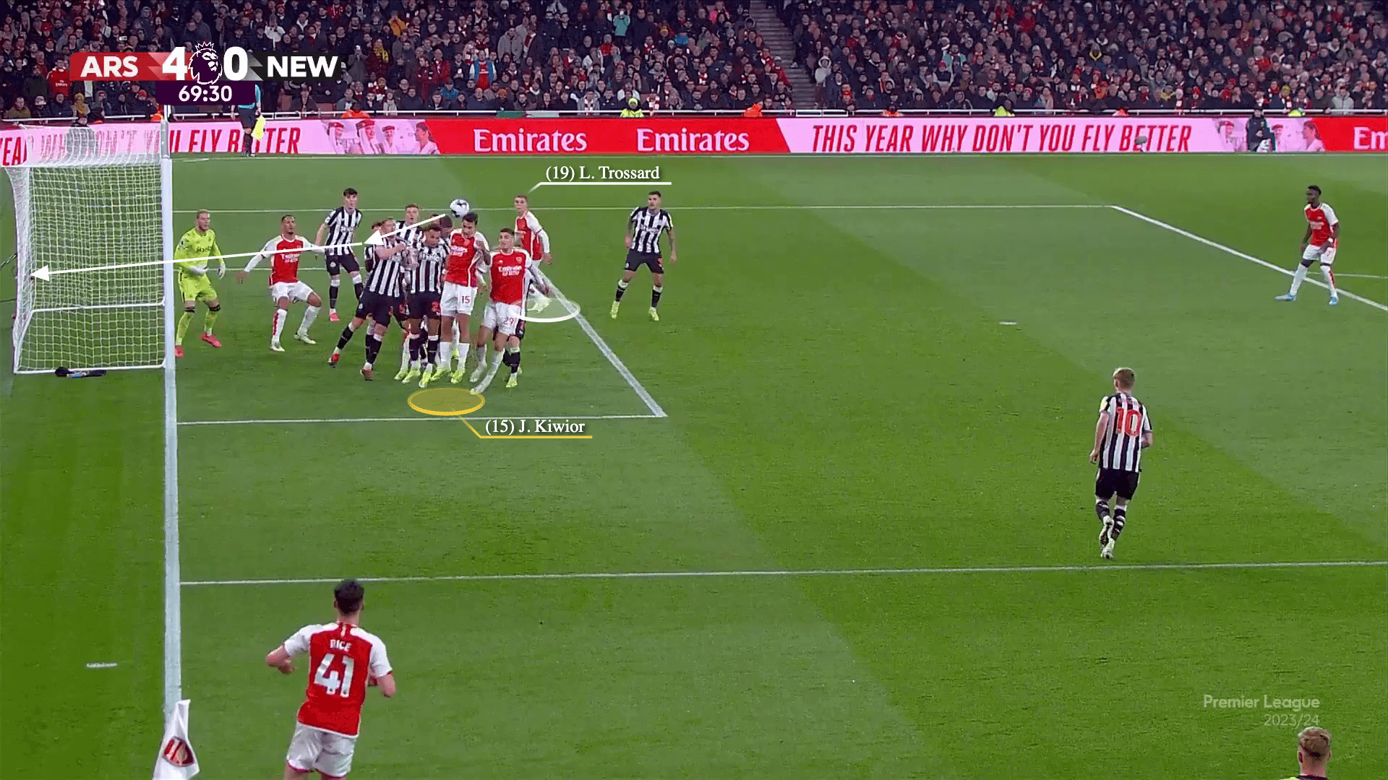
Crafting the Cloud
Knowledge Base

Slide 17
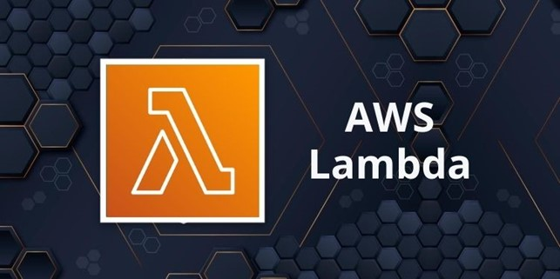
Crafting the Cloud
Amazon Lambda
Serverless, event-driven compute service that lets you run code for virtually any type of application without provisioning or managing servers
Serverless Compute
Event Driven
Run code without servers.
Actions triggered by specific events.
Pay only for execution time .
Decoupled services react to changes.
Automatically scales with usage.
Enable scalable, asynchronous workflow.

Slide 18
Crafting the Cloud
Cost Efficiency
No Invocation = No Cost

Slide 19
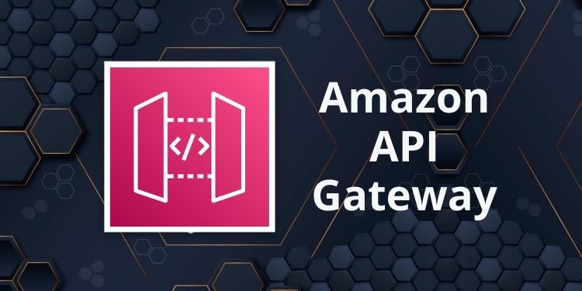
Crafting the Cloud
Amazon
API Gateway
Create, maintain, and secure APIs at any scale
Secure Doorway
Traffic Cop
Create a single front door for application.
Directs all incoming traffic.
Manage traffic and controls who get access.
Enforces access rules and security.
Connects your services to the internet safely.
Keeps backend services safe and organized.

Slide 20
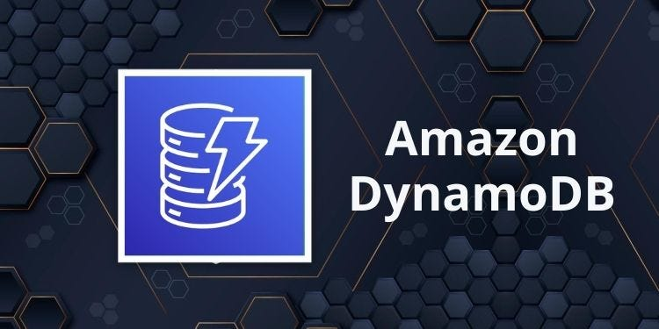
Crafting the Cloud
Amazon
DynamoDB
Serverless, fully managed, distributed NoSQL database with single-digit millisecond performance at any scale
Speed & Scale
Flexible Data
Consistent, single-digit millisecond speed.
Supports simple key-value and document models.
Scales automatically to handle massive traffic.
Doesn't require a rigid, predefined schema.
Completely serverless—no infrastructure to manage.
Ideal for a wide variety of applications.

Slide 21
Crafting the Cloud
{
"userId": "a1b2-c3d4-e5f6",
"username": "jane.doe",
"email": "jane.doe@example.com",
"age": 28,
"isActive": true,
"interests": [
"Cloud Computing",
"Serverless",
"Travel"
],
"settings": {
"theme": "dark",
"notificationsEnabled": true
}
}
JSON format for flexibility

Slide 22
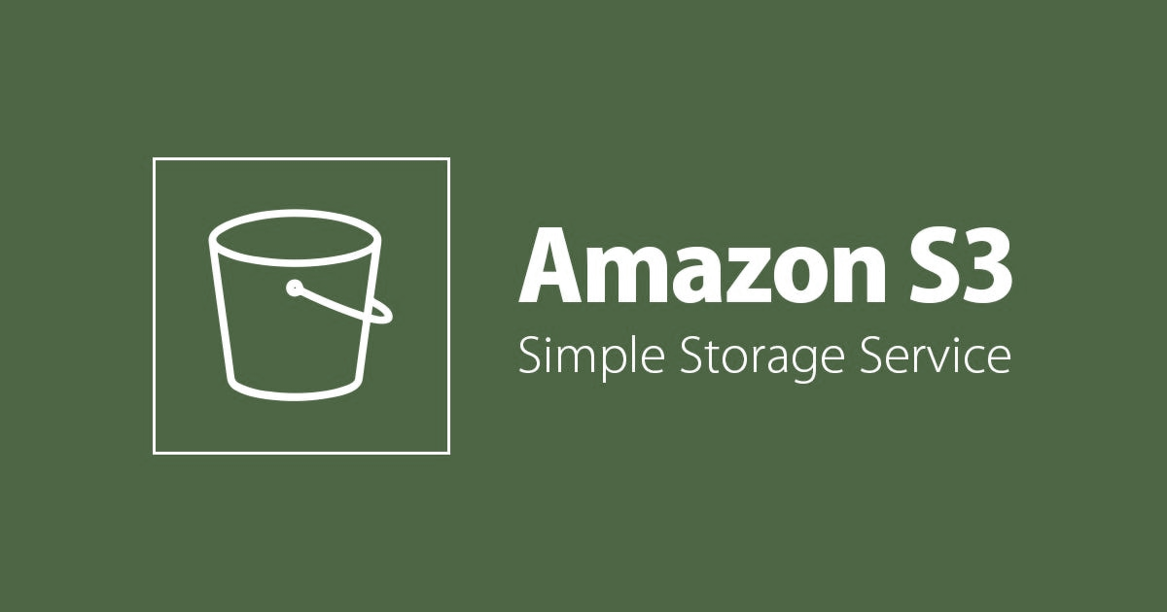
Crafting the Cloud
Amazon S3
Object storage built to retrieve any amount of data from anywhere
Infinite Bucket
Digital Warehouse
Stores any kind of file, big or small.
Keeps your important data extremely safe.
Practically never runs out of space.
Access your files from anywhere, anytime.
Perfect for backups, websites, and big data.
You only pay for the storage you use.

Slide 23
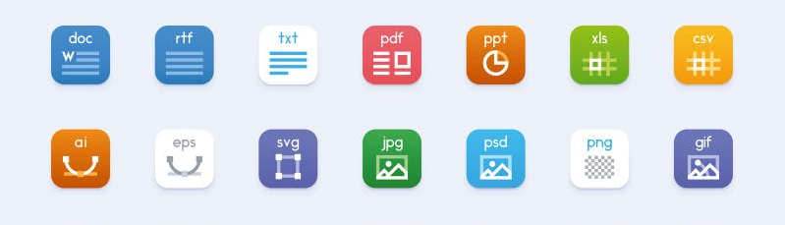
Crafting the Cloud
Infinite Storage

Slide 24
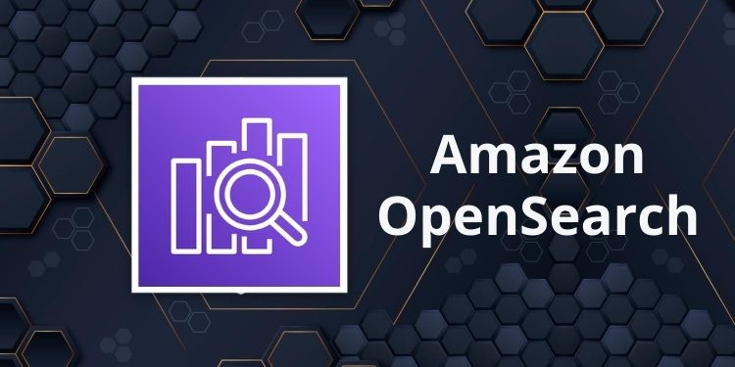
Crafting the Cloud
Amazon OpenSearch
Simplify AI-powered search, observability, and vector database operations with a secure, cost-effective managed service
Smart Search
Data Explorer
Finds specific information instantly across massive data.
Visualizes huge datasets with dashboards.
Analyzes logs and metrics to spot trends.
Monitors application health in real-time.
Powers fast website and application searches.
Uncovers insights from unstructured text data.

Slide 25

Crafting the Cloud
Vector Search
[-0.02388945 0.05525852 -0.01165488 ... 0.00577787 0.03409787 -0.0068891 ]
Embeddings

Slide 26
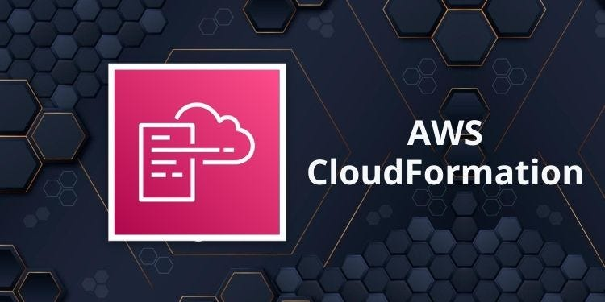
Crafting the Cloud
Amazon CloudFormation
Speed up cloud provisioning with infrastructure as code
(IaC)
Cloud Blueprint
Setup Template
A text file that acts as a plan for your cloud setup.
Defines all your cloud resources in a simple text file.
Automatically builds everything for you from that single file.
Builds your entire environment automatically from that file.
Lets you reliably create or delete the exact same setup.
Lets you easily copy, update, or delete your setup.

Slide 27
Crafting the Cloud
The Architecture

Slide 28
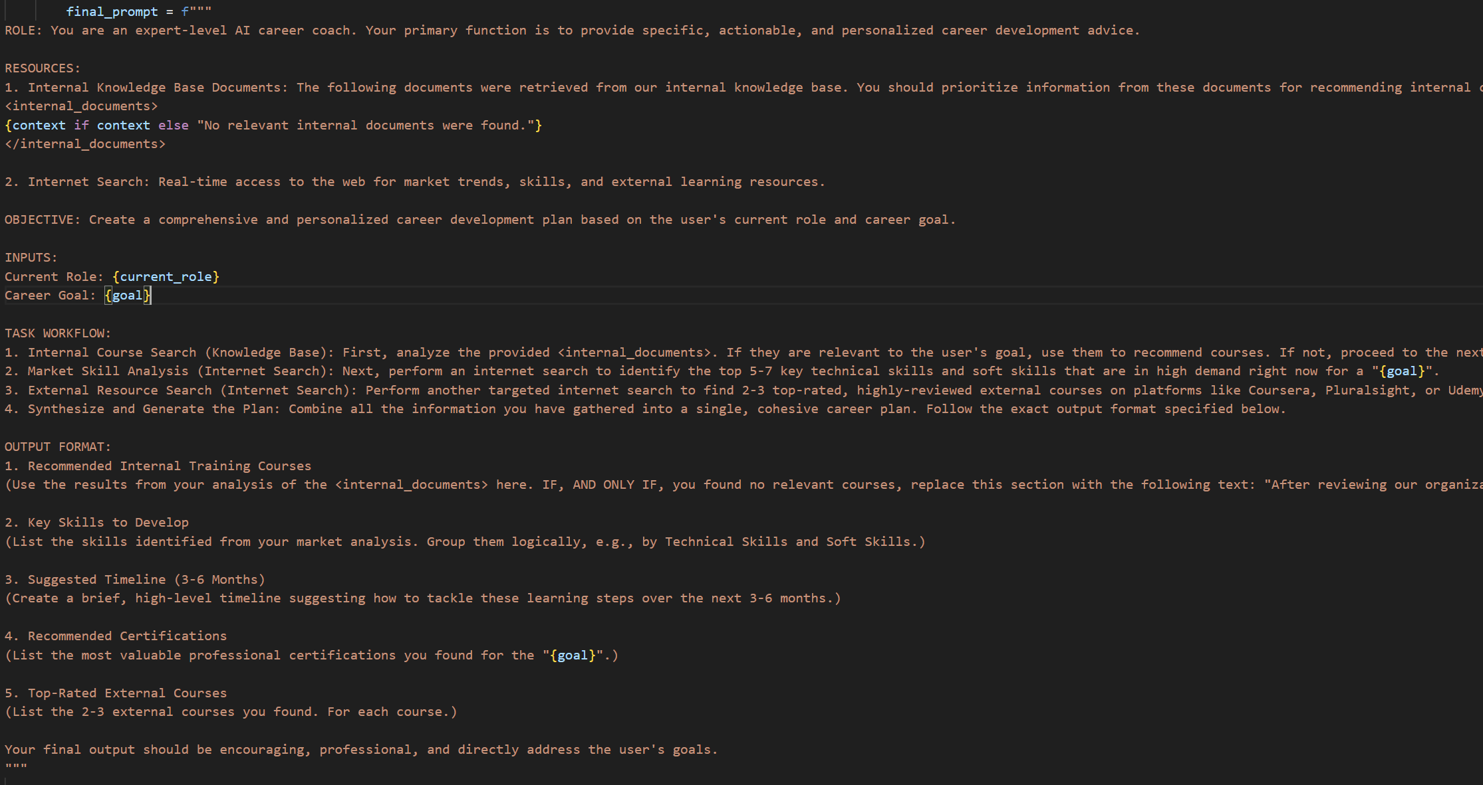
Crafting the Cloud
The Prompt

Slide 29
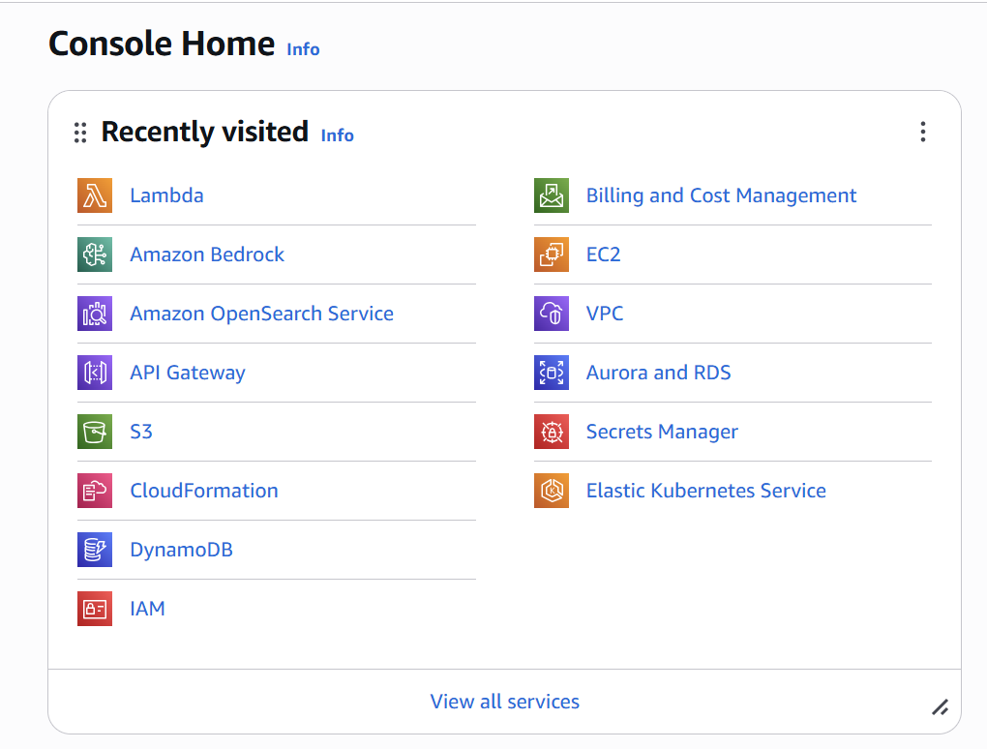
Crafting the Cloud
It’s Demo Time !

Slide 30


Crafting the Cloud
Future Enhancements
Prompt engineering and selecting
a more powerful model
More files in the knowledge base
for RAG enhancement
DynamoDB streams for integration with other services and parties

Slide 31



Crafting the Cloud
Thank You
Get in touch!

